Slide 1
Java Packages
Rajasekaran S
Assistant Professor,
Department of Information Technology,
KGiSL Institute of Technology,
email: proffraja@gmail.com
Github:www.github.com/rajasekaranap

Slide 2
Packages
A java package is a group of similar types of classes, interfaces and sub-packages.
It is used to organize our works and also it separates from other predefined package’s and third party package’s.

Slide 3
Advantages of Packaging
Java package is used to categorize the classes and interfaces so that they can be easily maintained.
Java packages provides access protection.
It help’s to avoid naming collation.

Slide 4
Types of Packages
JAVA PACKAGES
Built-In Packages
User defined Packages

Slide 5
Built-in Packages and Classes
String
java.lang.String
InputStreamReader
java.io.InputStreamReader
BufferedReader
java.io.BufferedReader
Integer
java.lang.Integer

Slide 6
Visual
java
lang
String
Integer
io
BufferedReader
InputStreamReader

Slide 7
How can we create our own package
Step 1:
Define package name in program.
Step 2:
Compile the code as follows
Javac –d directorypath Source.java [Syntax].
Javac –d . Main.java [Example].
-d is directory switch for javac
Dot [ . ] Represents the current directory [It can be any path like D:/Examples/PackageExamples…]

Slide 8
How can we create our own package
Step 3
Run a program with fully qualified class name
Java packagename.ClassName [Syntax]
Java mypack.Main [Example]
Fully Qualified Name [FQCN]
Sometimes when we importing packages with * some naming collision may happen.
To avoid such situation we need to use fully qualified name.
We should aware of access modifiers too.

Slide 9
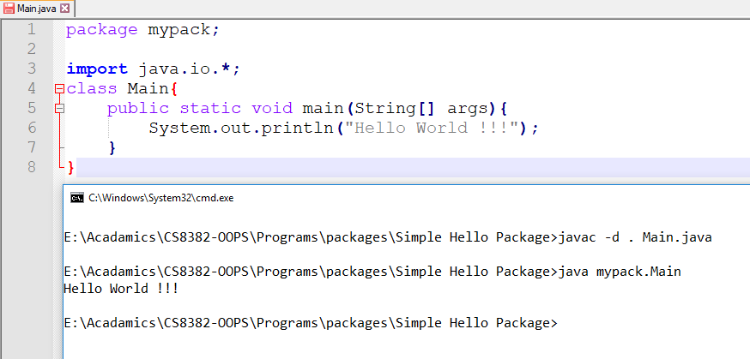
Hello World Program with packages
Package statement
Options
-d = directory
. = current directory path
Fully Qualified Class Name
Compiling

Slide 10
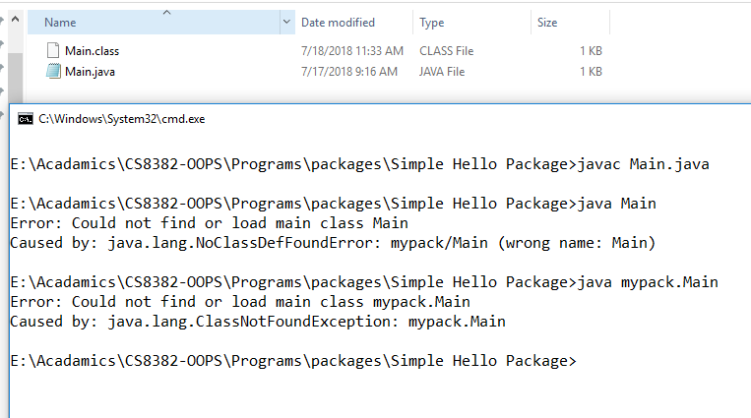
Trying to Access With out FQCN

Slide 11
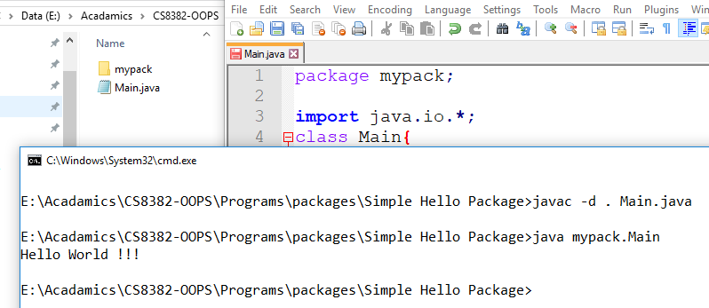
Proper Way

Slide 12
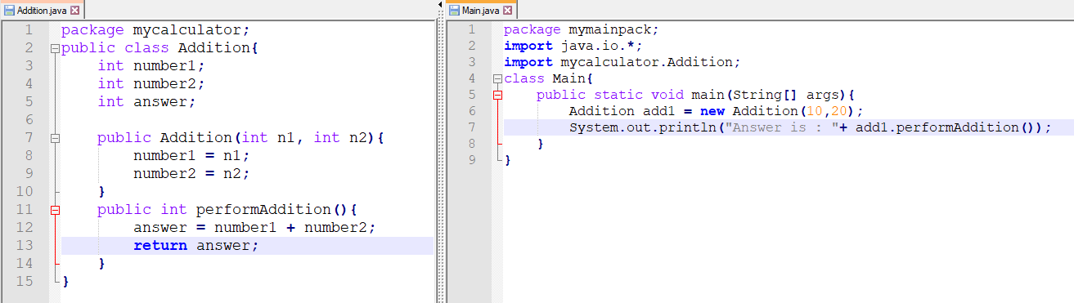
Creating Packages and Importing
Creating Package
Importing your package

Slide 13
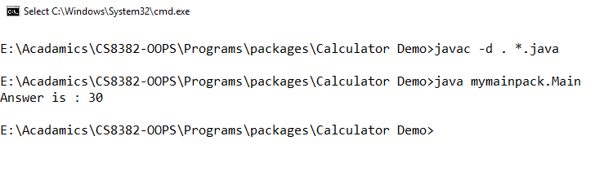
Output

Slide 14
Sub packages
We can create sub packages too.
Levels of packages separated with dot[.]
Eg:
Java.io.BufferedReader
Main Package
Sub Package
Class Name

Slide 15
Access Specifies
It is a set of keywords that used to restrict the scope of a class, constructor , variable , method or data member.
It is also known as access modifiers
There are 4 modifiers.
Public
Private
Protected
Default

Slide 16
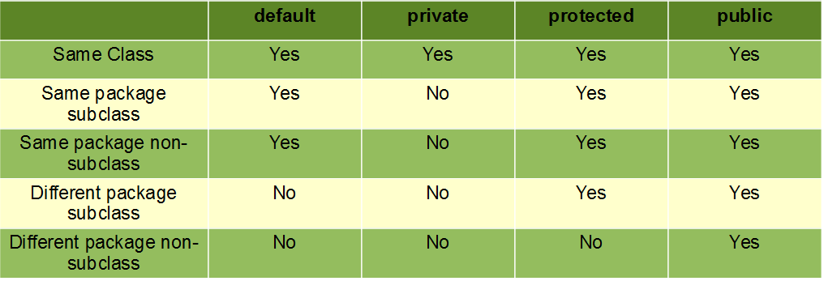
Access Specifies vs Scope

Slide 17
Thank You
Rajasekaran S
Assistant Professor,
Department of Information Technology,
KGiSL Institute of Technology,
email: proffraja@gmail.com
Github:www.github.com/rajasekaranap

